Slide 1
Today's IEEE:
Career, Content, and Networking
iGroup China
2014

Slide 2
目录
IEEE 简介
IEL 数据库及 IEEE Xplore 平台介绍
IEEE 期刊会议投稿流程及注意事项
IEEE 相关资源推介

Slide 3

IEEE简介

Slide 4
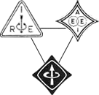
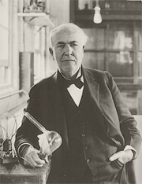
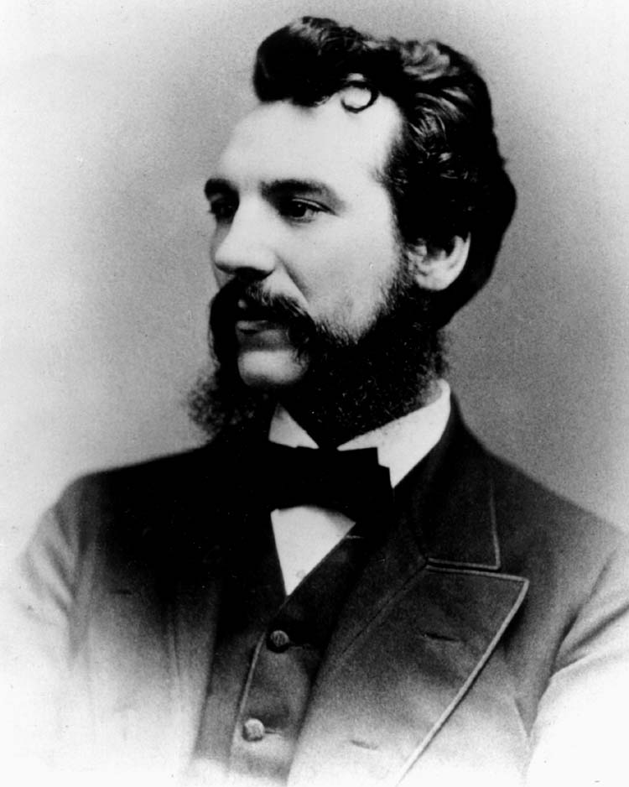
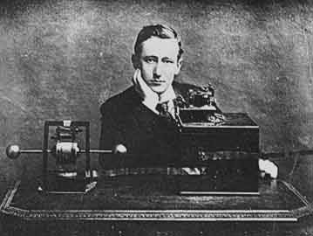
你认识他们吗?
AIEE
IRE

Slide 5

IEEE Volunteer Activities
非盈利组织，全球最大的技术行业协会，成员遍布160多个国家地区，会员超过40万人
  38个技术协会和7个技术委员会
  329个地方分会
    1860个专业技术委员会
    80个国家的2000多个学生分会
每年在全球范围内举办1000多场会议
出版世界电气电子工程和计算机领域30％的文献
提供1000多个现行的产业标准，及500个正在制定的标准

Slide 6
IEEE Societies
IEEE Instrumentation and Measurement Society
IEEE Intelligent Transportation Systems Society
IEEE Magnetics Society
IEEE Microwave Theory and Techniques Society
IEEE Nuclear and Plasma Sciences Society
IEEE Oceanic Engineering Society
IEEE Photonics Society
IEEE Power Electronics Society
IEEE Power and Energy Society
IEEE Product Safety Engineering Society
IEEE Professional Communications Society
IEEE Reliability Society
IEEE Robotics and Automation Society
IEEE Signal Processing Society
IEEE Society on Social Implications of Technology
IEEE Solid-State Circuits Society
IEEE Systems, Man, and Cybernetics Society
IEEE Ultrasonics, Ferroelectrics, and Frequency Control Society
IEEE Vehicular Technology Society
IEEE Aerospace and Electronic Systems Society
IEEE Antennas and Propagation Society
IEEE Broadcast Technology Society
IEEE Circuits and Systems Society
IEEE Communications Society
IEEE Components, Packaging, and Manufacturing Technology Society
IEEE Computational Intelligence Society
IEEE Computer Society
IEEE Consumer Electronics Society
IEEE Control Systems Society
IEEE Dielectrics and Electrical Insulation Society
IEEE Education Society
IEEE Electron Devices Society
IEEE Electromagnetic Compatibility Society
IEEE Engineering in Medicine and Biology Society
IEEE Geoscience and Remote Sensing Society
IEEE Industrial Electronics Society
IEEE Industry Applications Society
IEEE Information Theory Society

Slide 7
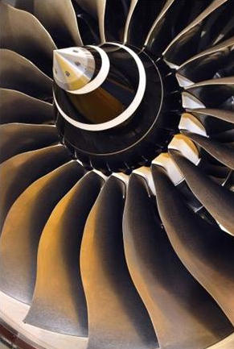
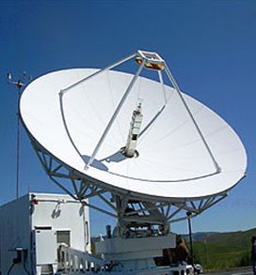



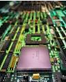
IEEE涵盖各个科技领域
More than just electrical engineering & computer science
• Information Technology
• Medical Devices
• Nanotechnology
• Optics
• Petroleum & Gas
• Power Electronics
• Power Systems
• Robotics & Automation
• Semiconductors
• Smart Grid
• Wireless Broadband
and many more
• Aerospace & Defense
• Automotive Engineering
• Biomedical Engineering
• Biometrics
• Circuits & Systems
• Cloud Computing
• Communications
• Computer Software
• Electronics
• Energy
• Engineering
• Imaging

Slide 8
IEL数据库及IEEE Xplore平台介绍

Slide 9
从IEEE Xplore可以获得哪些内容？
IEEE/IET Electronic Library （简称IEL）
  主要包含三个机构的出版物
    IEEE -Institute of Electrical & Electronic Engineers Inc.
        电气电子工程师学会
    IET-The Institution of Engineering & Technology
        国际工程和技术学会
        (前身为IEE英国电气工程师学会)
    VDE-德国电气工程师协会
IEEE Xplore：IEL数据库的登录平台名称

Slide 10

IEEE Xplore全文数据库
3百多万篇全文文档
170+ IEEE 期刊和杂志
1200+ IEEE会议录（每年）
2600+ IEEE标准文档（标准草案除外）
20+ IET期刊和杂志
40+ IET会议录（每年）
60+ VDE会议录
完整文档回溯到1988，最早到1872
600+ IEEE-Wiley电子书
500+ MIT电子书
IBM Journal of Research & Development (including IBM Systems Journal)
300+ 电子学习课件
5 AIP/AVS 期刊，TUP（OA）,AIBI

Slide 11
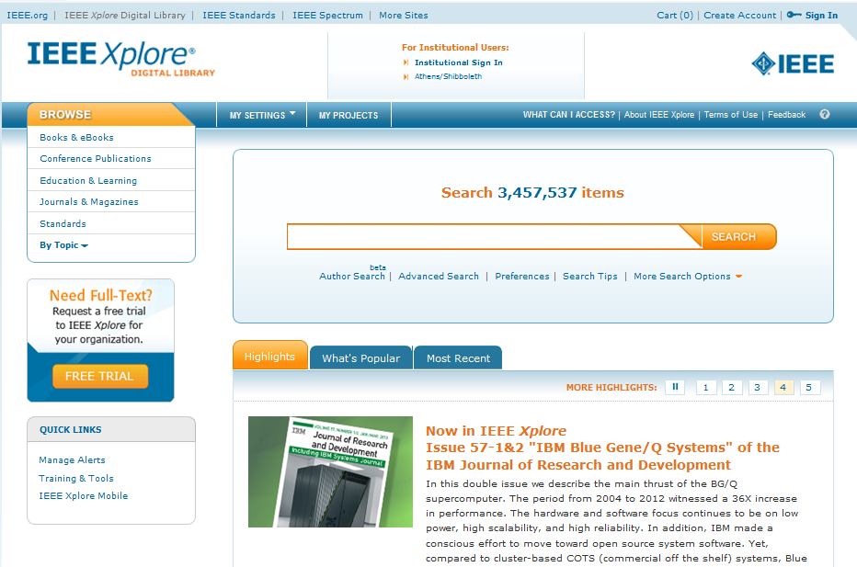
IEEE Xplore平台
http://ieeexplore.ieee.org

Slide 12
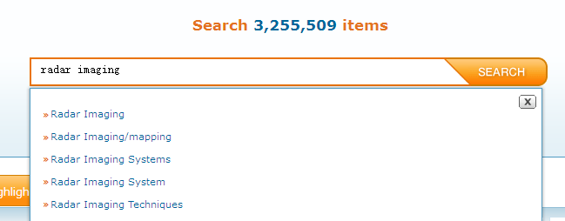

检索入口
ANDs search terms ie. fiber optics= fiber AND optics
Use quotes (“”) for an exact phrase ie. “fiber optics”
Searching metadata only NOT a Full text search
Automatic stemming
Case insensitive
Type-ahead (also known as auto suggest) functionality

Slide 13
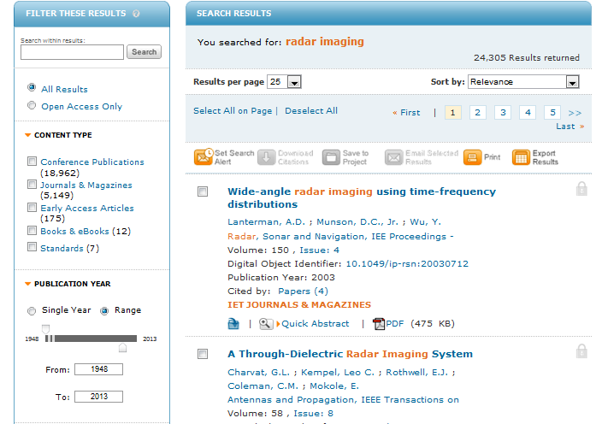
检索结果

Slide 14
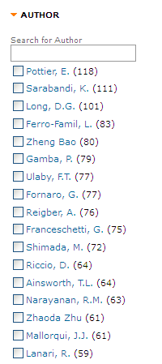
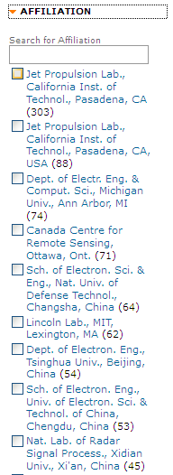
定位顶尖作者和机构

Slide 15
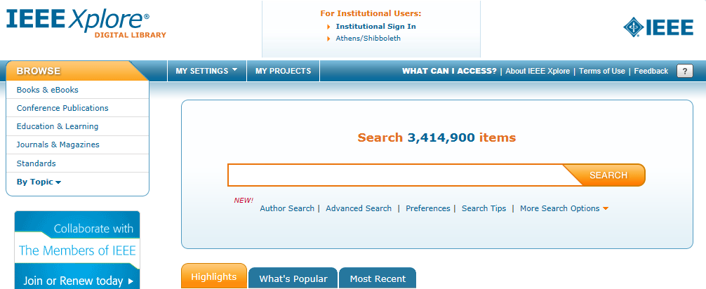
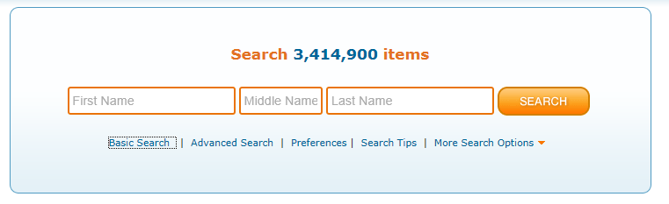
Author Search

Slide 16
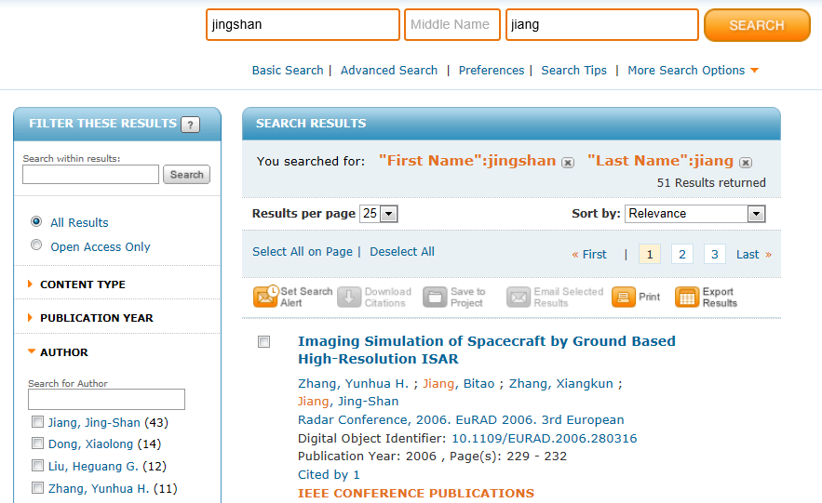

Slide 17
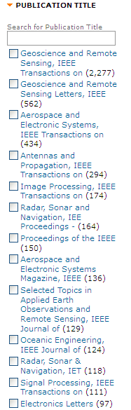
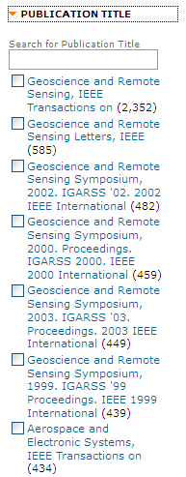
定位相关期刊和会议

Slide 18
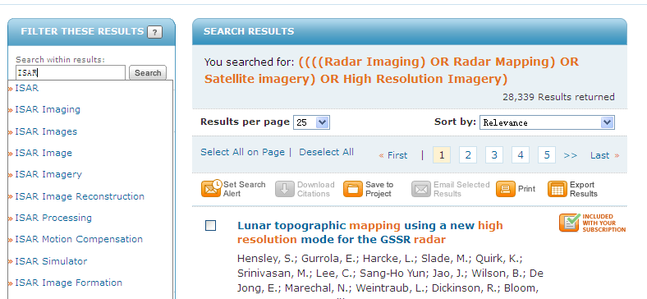
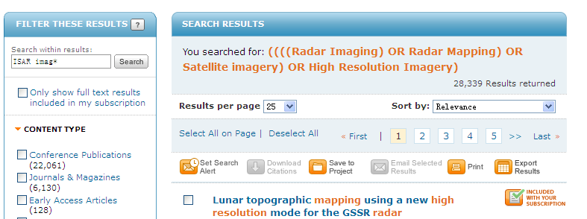
缩检

Slide 19
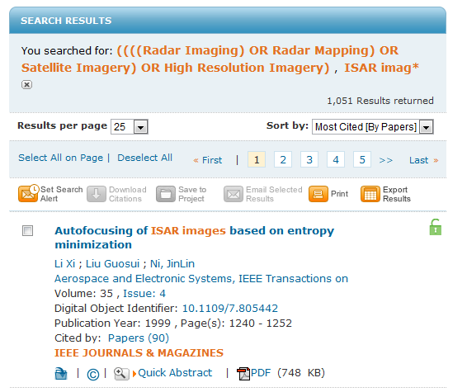
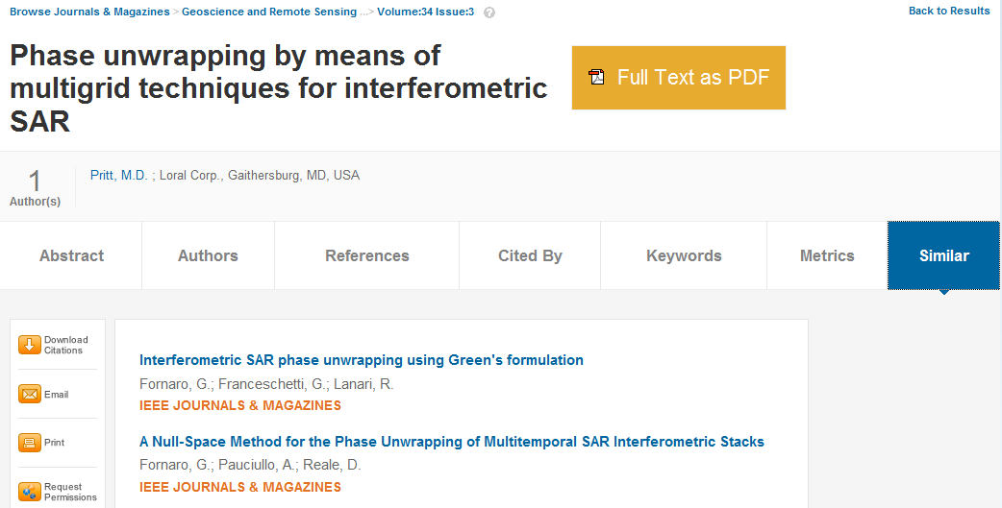
找出最有影响力的文章

Slide 20
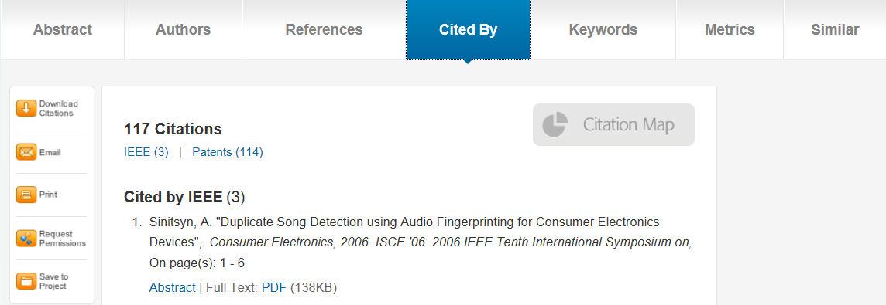
查看专利对文献的引用情况

Slide 21
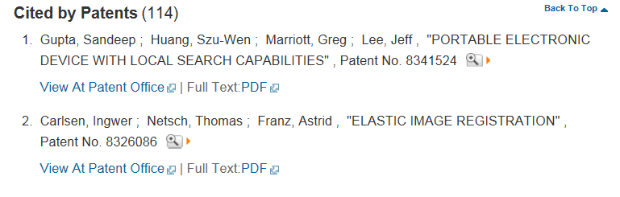
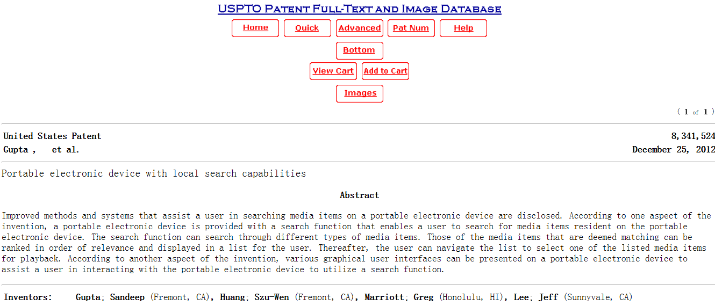
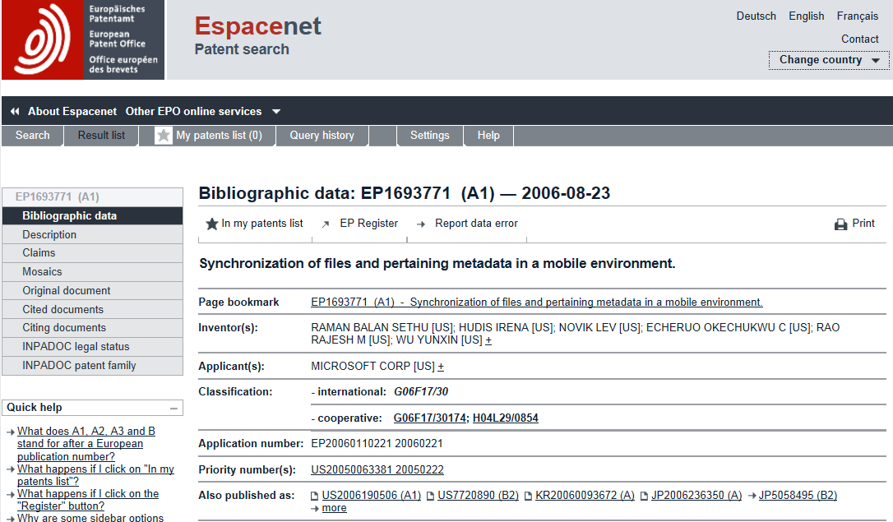
Links to USPTO&EPO

Slide 22
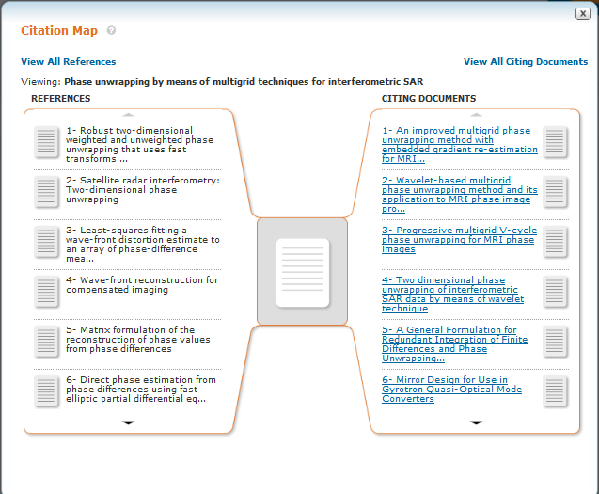
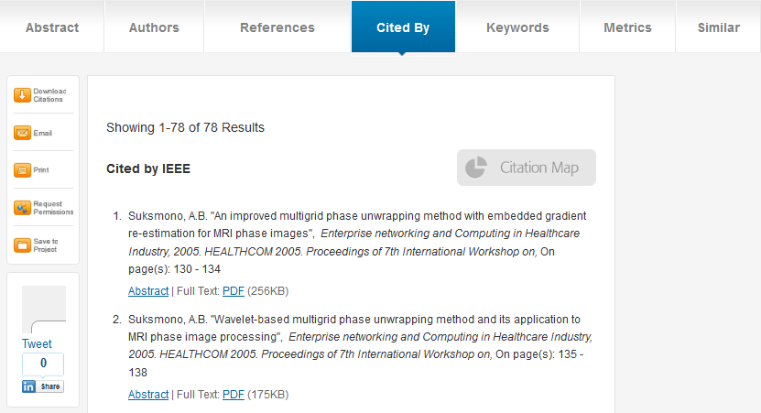
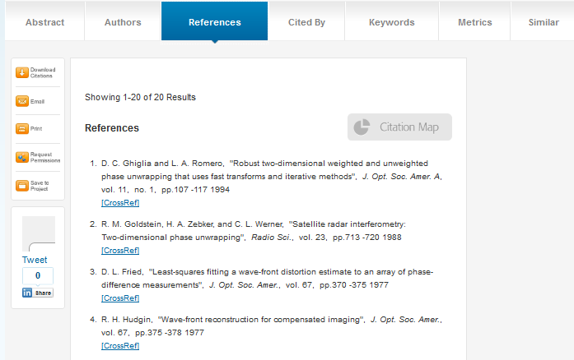
追溯相关文献与最新动态

Slide 23
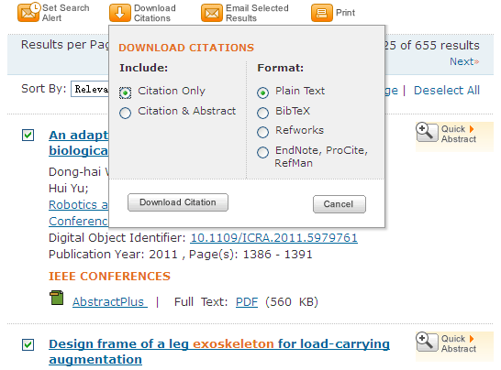
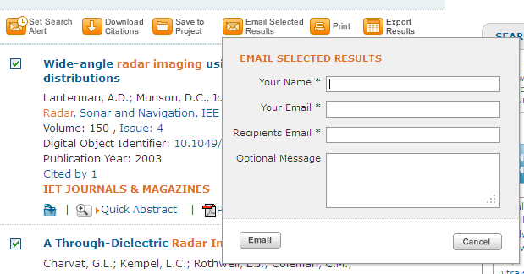
利用参考文献工具管理引文

Slide 24
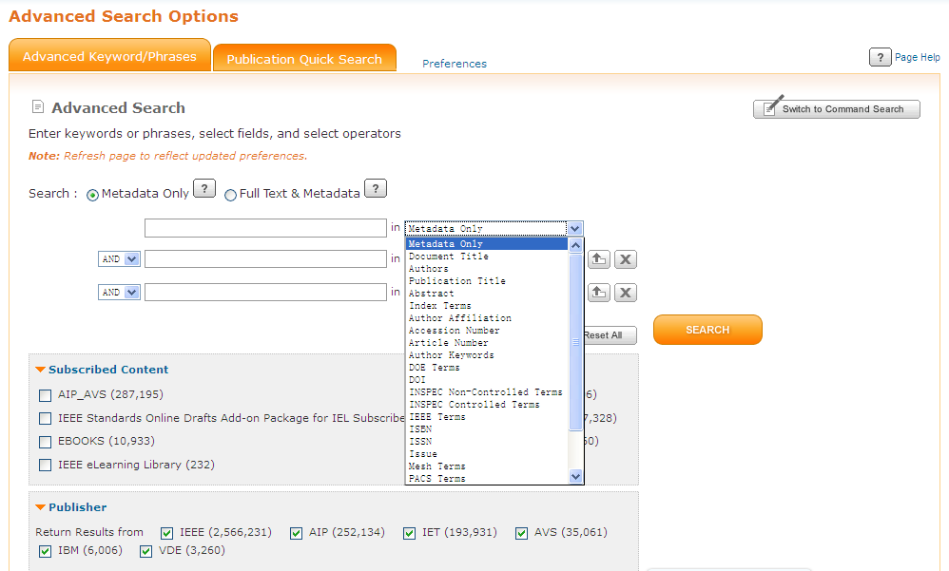
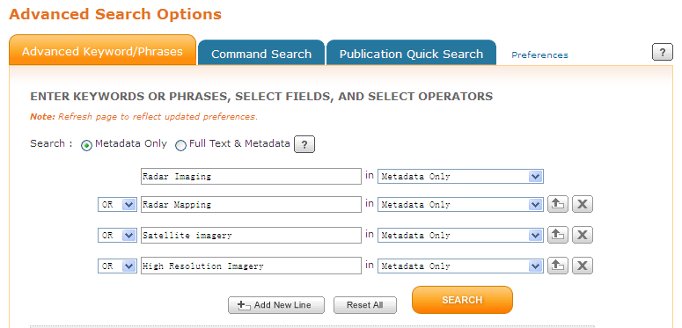
高级检索

Slide 25
Wildcard
Use * as truncation – Fiber*
Max 5 * wildcards per search- but you can use an additional one via “Search Within Results”
“fiber*”- invalid

Slide 26
Limitation
Max 15 terms in Global Search and Advanced Search
The words within phrases are counted separately
You may use an additional terms via “Search Within Results”

Slide 27
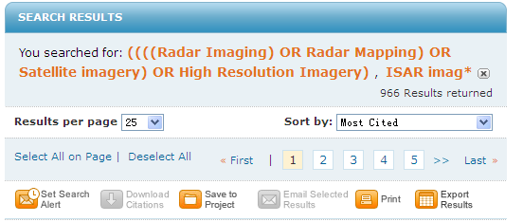
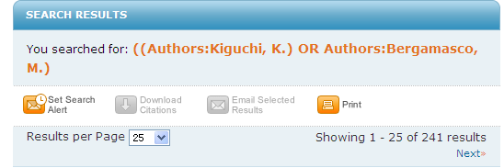
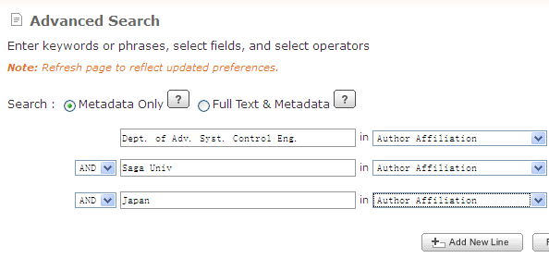
跟踪权威专家/机构/领域，获取最新科研动态

Slide 28
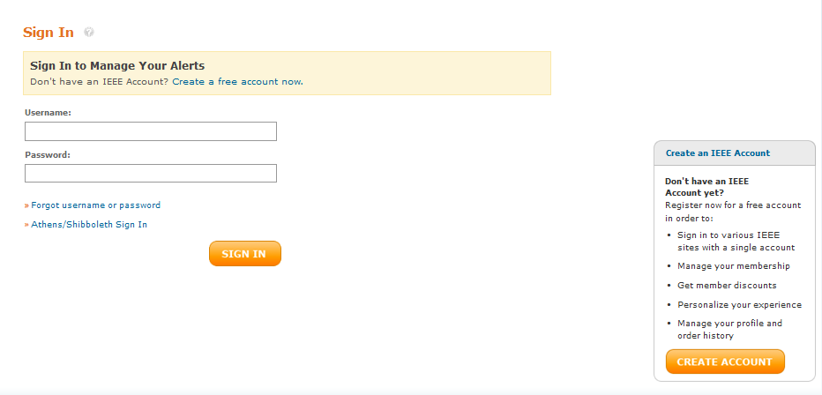
个性化功能-设置个人帐号
所有用户需要设置个人帐号以保存ToC Alerts, Saved search 和设置Preference
注：IEEE会员可以会员帐号登录

Slide 29
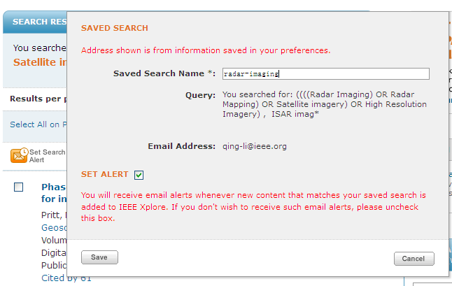
个性化功能-Save Search

Slide 30

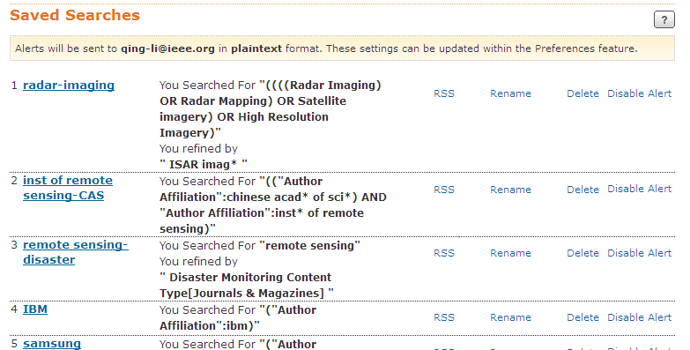
个性化功能-查看Saved Searches
最多可保存15个检索式

Slide 31
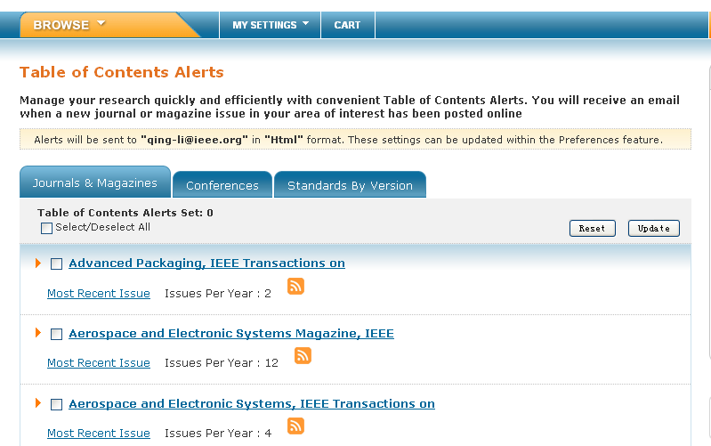

个性化功能-设置ToC Alerts

Slide 32
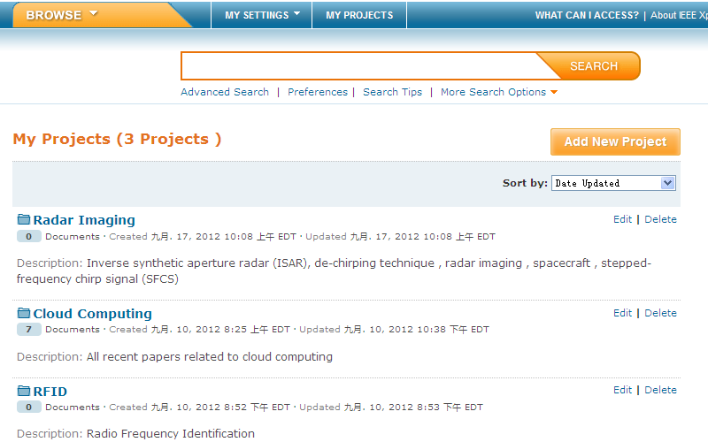
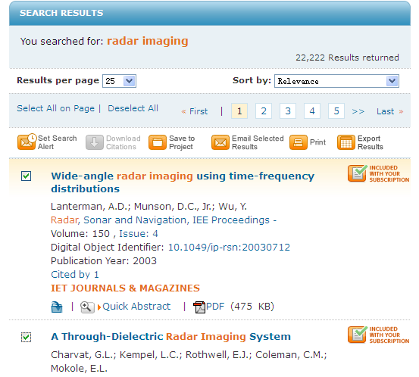
个性化功能-My Projects

Slide 33
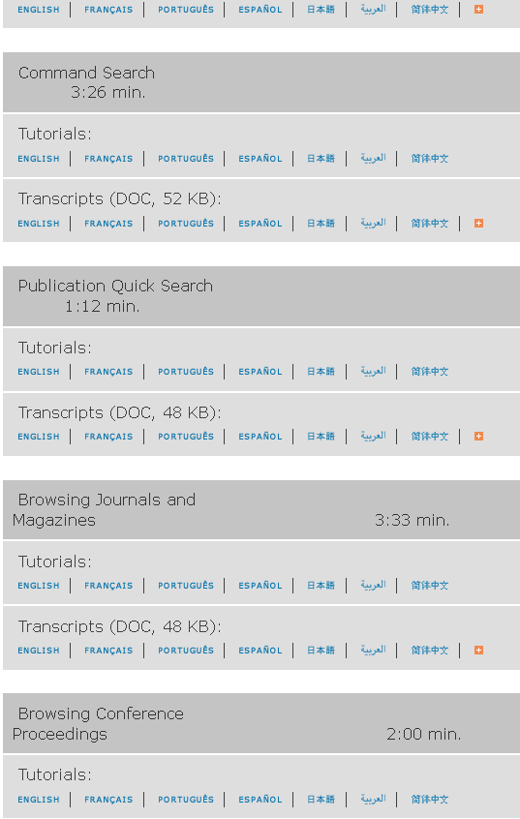
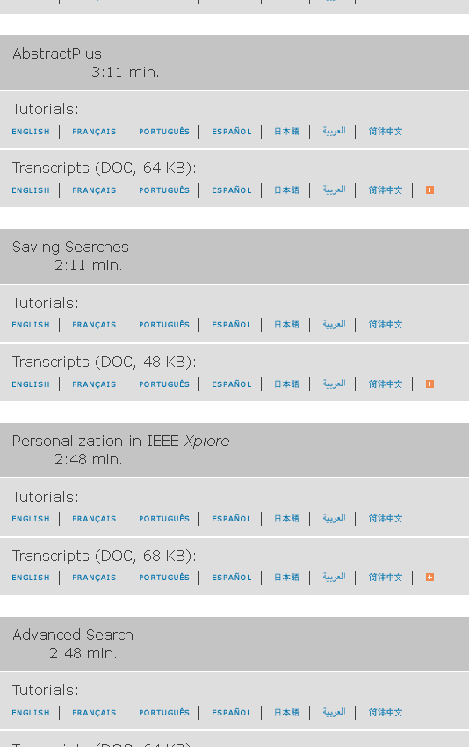
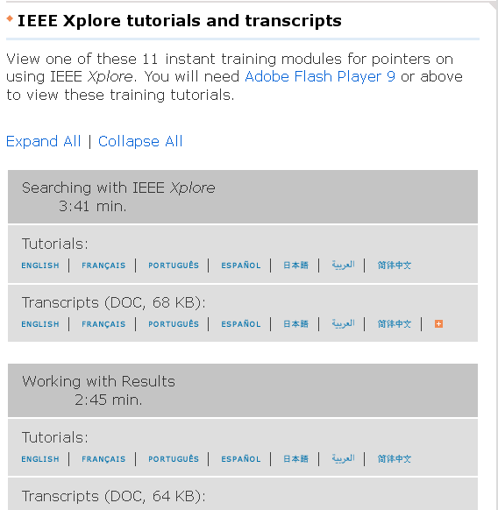
Additional IEEE support http://www.ieee.org/training

Slide 34
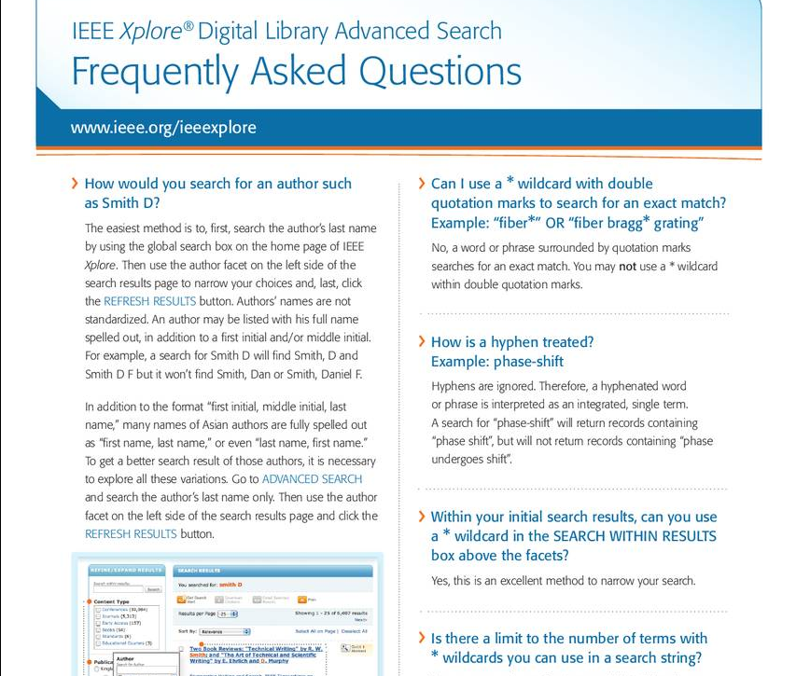
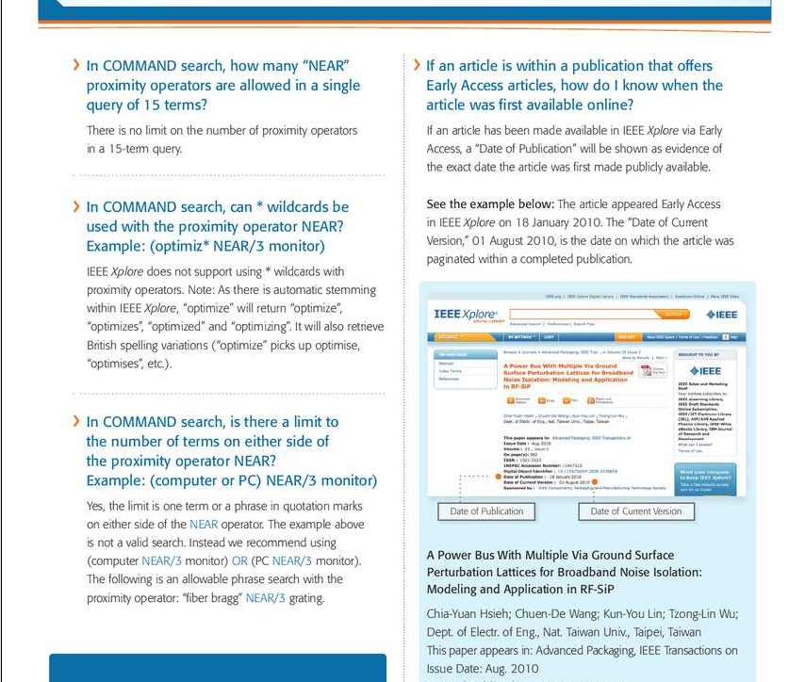
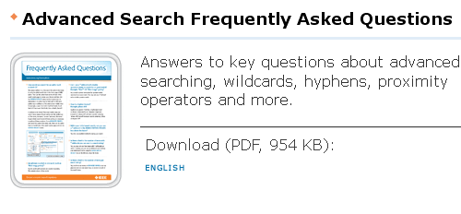
Advanced tip sheet http://www.ieee.org/publications_standards/publications/subscriptions/clientservices/promote/user_guides.html

Slide 35
IEEE期刊会议投稿流程及注意事项

Slide 36

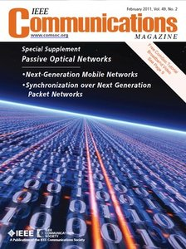
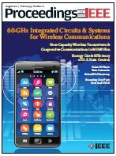

What are the opportunities to publish at IEEE?
170+
Journals, Transactions, Magazines
Notes:
What are the opportunities to publish at IEEE?
IEEE's 154 journals, transactions, magazines, and more than 1,200 conferences around the world allow authors to find the best forum for their work.
This wealth of information allows researchers to find exactly what they need among the more than three million documents in IEEE Xplore.
Authors can be "found" where their work belongs.

Slide 37
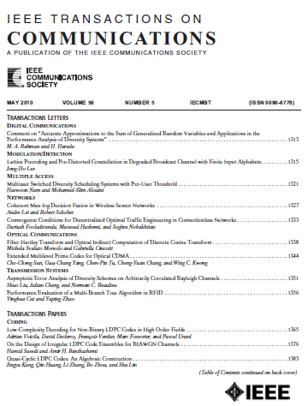





Journals Magazines

Slide 38

以MTT刊物为例
 | Transactions | Letters | Magazine
NewResearch Article | YES(6pages, over-lengthcharge) | YES(3pages) | NO
TutorialArticle | YES(atexpert level) | NO | YES(atFundamental toIntermediatelevel)
Application Note | NO | NO | YES
ReviewArticle | YES(atexpert level) | NO | YES(atFundamental toIntermediatelevel)
Research Article: Papers in the journals use the IEEE standard format and must include a Title, Abstract, Introduction, Technical Content, Conclusions, and References. The transactions also include the author biographies.
Tutorial: Unique presentation of known material. Valuable methodologies, exhaustive references
Application Note: Describe current application of technology: circuits, systems, models, concepts.
Review: Historical account of field, exhaustive references, explanation of state-of-the-art, indications of future research

Slide 39

Quality You Can Trust
Journal Citation Report Results, by Impact Factor
2012JCR报告对IEL期刊收录情况
IEEE publishes:
18 of top 20 journals in Electrical and Electronic Engineering
10 of top 10 journals in Telecommunications
4 of top5 journals in Automation & Control Systems
4 of top 5 journals in Computer Hardware & Architecture
4 of top 5 journals in Computer Science, Artificial Intelligence
# 1 in Automation & Control
# 1 in Artificial Intelligence
# 1 in Cybernetics
# 1 in Hardware& Architecture
# 1 in Industrial Engineering
# 2 in Imaging Science
# 2 in Remote Sensing
The ISI JCR presents “quantifiable statistical data that provides a systematic, objective way to evaluate the world’s leading journals”
(2012 report released June 2013)

Slide 40

Find Journals on IEEE Xplore

Slide 41


Slide 42


Slide 43

电子投稿：E-Submission

Slide 44

注册帐号

Slide 45

进入作者专区
http://mchelp.manuscriptcentral.com/gethelpnow/

Slide 46

评审流程
Review Process
e.g. IEEE Transactions on Information Technology in Biomedicine

Slide 47

投稿格式：Tools for Authors
http://www.ieee.org/publications_standards/publications/authors/authors_journals.html

Slide 48



利用参考文献管理工具设置格式

Slide 49

利用参考文献管理工具设置格式

Slide 50

IEEE Reference Preparation Assistant
http://refassist.ieee.org/action/showAuthorLogin

Slide 51

Editing Assistance
http://www.prof-editing.com/ieee/index.php

Slide 52

What are the opportunities to publish at IEEE?
1,200+
Conferences
170+
Journals, Transactions, Magazines
Notes:
What are the opportunities to publish at IEEE?
IEEE's 154 journals, transactions, magazines, and more than 1,200 conferences around the world allow authors to find the best forum for their work.
This wealth of information allows researchers to find exactly what they need among the more than three million documents in IEEE Xplore.
Authors can be "found" where their work belongs.

Slide 53
会议论文和期刊论文的区别
会议主要目的是通过演讲现场交流信息和交换想法
会议常常反映最新最前沿的研究，很多研究尚未到达正式期刊发表的程度。所以会议主要是快速传播科研信息，以从观众中获取宝贵的意见和反馈
会议常常会尽可能能覆盖较多的参与者，所以很多会议论文接受率较高
期刊发表体现更严格的评审以及更高质量的成果
没有演讲此类口头交流信息的形式
大部分期刊论文至少有3名以上评审人审稿，并有副主编定稿
期刊论文必须很好地反映该领域研究状态，因为评审人会仔细审核其引用文献
期刊论文接受率通常远低于会议论文

Slide 54


浏览与参加IEEE会议

Slide 55



查找即将召开的IEEE会议
www.ieee.org/conferences

Slide 56


Slide 57




Slide 58

EDAS
http://edas.info/doc/authors.html

Slide 59
IEEE相关资源推介

Slide 60

IEEE标准- Standards
        National Electrical Safety Code® (NESC) – Authority on safety requirements for power, telephone, cable TV, and railroad signal systems
        Color Books: IEEE 141-1993 (Red book), IEEE 142-1991 (Green book), IEEE 1100-1999 (Emerald book), IEEE 242-2001(Buff book)
        IEEE 802.3™ - Ethernet
        IEEE 802.11™- Wireless Networking
        IEEE 802.16™ - Broadband Wireless Access (WiMAX)
        IEEE1547-2003 – Interconnecting distributed resources with electric power systems
        IEEE 519-1992 –Power systems communications – Harmonic in electric power systems
        IEEE 1149.1-2001 – Test technology -Test Access Port and Boundary--Scan Architecture
        IEEE 1012-2004™ - Software Engineering – Software Verification and Validation
        ISO/IEC 16085 –IEEE 1450-2001-Software Life Cycle Processes-Risk Management
        IEEE C57.10.00-2000 –General Requirements for--Liquid-Immersed Distribution, Power, and Regulating Transformers

Slide 61

IEEE 标准开发流程

Slide 62

标准状态
Draft：还没有被批准为标准的标准项目；
Active：要求周期性维护的已批准的标准；
Archived：已经存档的标准，
Withdrawn：不再维护的标准，可包含过时或者错误信息

Slide 63

IEEE Online Standards Dictionary

Slide 64


IEEE Online Standards Dictionary

Slide 65
欢迎IEEE协会活动！
Involvement in IEEE Societies, Sections and Chapters
2，400 IEEE Student Branches worldwide
Participation in IEEE GOLD (Graduates of the Last Decade) and Women in Engineering
1000+ conferences per year
IEEE MemberNet, MentorNet, LinkedIn, Facebook and Twitter

Slide 66
IEEE Student Branches in China
目前中国的学生会员已经超过4000人。
通过学生分会通过开展特定的项目、活动，开拓青少年的科学眼界，培养其工程素养。
迄今为止，中国学生分会的数目已达30个。
  IEEE河北大学学生分会
  IEEE中国科学院研究生院学生分会
  IEEE清华大学学生分会
  IEEE哈尔滨工业大学深圳研究生院学生分会
  IEEE北京邮电大学学生分会
  IEEE北京交通大学学生分会
  IEEE北京大学学生分会
  IEEE北京工业大学学生分
  IEEE北京理工大学
  IEEE北京大学深圳研究生院学生分会
  IEEE北京航天航空大学学生分会
  IEEE重庆大学学生分会
  IEEE电子科技大学学生分会
  IEEE华南理工大学学生分会
  IEEE中山大学学生分会
  IEEE哈尔滨工业大学学生分会
  IEEE东南大学学生分会
  IEEE南京理工学生分会
  IEEE浙江大学学生分会
  IEEE上海交通大学学生分会
  IEEE上海华东师范大学学生分会
  IEEE上海微系统所学生分会
  IEEE华中科技大学学生分会
  IEEE西安交通大学学生分会
  IEEE西北工业大学学生分会
  IEEE西安电子科技大学学生分会
  IEEE山东大学学生分会
  IEEE天津大学学生分会
  IEEE中国科技大学学生分会
  IEEE郑州大学学生分会

Slide 67

IEEE免费技术讲座
Spectrum免费讲座，涉及最新科技：http://spectrum.ieee.org/webinar/；
Communication Society免费讲座，通信领域热点技术：http://www.comsoc.org/webinars
Computer Society免费讲座，计算机领域热点技术:
http://www.computer.org/portal/web/webinars/Register-for-a-Webinar
GOLD社团免费讲座，涉及职业发展，人文，科技等内容：http://www.ieee.org/membership_services/membership/gold/events/index.html
加入志愿者虚拟社团，获得行业最新咨询：https://www.ieeecommunities.org/

Slide 68

IEEE个人会员
Student Membership: 27$
E-Membership:57$
Regular Membership: 147$
http://cn.ieee.org/membership_join.html

Slide 69
欢迎申请丰厚的IEEE奖学金！
IEEE Fellowship/Scholarship
  IEEE Charles LeGeyt Fortescue Fellowship
  IEEE Computational Intelligence Society Conference Travel Grants
  IEEE Computational Intelligence Society Summer Research Grant
  IEEE Components, Packaging, and Manufacturing Technology Society Graduate Fellowship for Research on Electronic Packaging
  IEEE Computer Society Merwin Scholarship
  IEEE Dielectrics and Electrical Insulation Society Graduate Student
  IEEE Electron Devices Society Graduate Student Fellowship
  ……
IEEE Competitions
  Presidents' Change the World Competition
  IEEE Computer Society Simulator Design Competition
  Student paper contest
  ……
http://ieee.org/membership_services/membership/students/awards/index.html

Slide 70




Slide 71
IEEE学生竞赛
Engineering Projects in Community Service (EPICS)http://www.ieee.org/education_careers/education/preuniversity/epics_high.html
Engineering for Changehttps://www.engineeringforchange.org
IEEE Xtreme 24-Hour Programming Competition http://www.ieee.org/xtreme
  IEEE Presidents’ Change the World Competition www.ieee.org/changetheworld
  Smarter Planet Challenge
  http://www.ieee.org/go/smarter_planet_challenge

Slide 72


Exciting Contest!
IEEE Xtreme Programming 极限编程大赛
Worldwide, 24-hour programming challenge for IEEE Student Branches
Top prize is a trip anywhere in the world to the IEEE event of the top team’s choice!

Slide 73




Exciting Contest!
IEEE President’s “Change the World” Competition
Recognizes students or teams of students who develop unique solutions to real-world problems using engineering, science, computing and leadership skills to benefit their community or humanity
Opportunity to win US $10,000
US $ 5,000
US $ 2,500

Slide 74

2014上半年网络课堂系列
主题一：如何利用IEEE Xplore提升科研效率
  IEEE Xplore数据库使用入门
  IEEE Xplore数据库使用进阶
主题二：如何成为IEEE作者
  IEEE期刊投稿流程与注意事项
  IEEE会议投稿流程与注意事项
  IEEE期刊投稿格式
  科技英文写作
主题三：走进全球最大的专业科技协会- IEEE学术研究与交流环境详解
主题四：创新的起点-IEEE标准协会与标准检索详解
主题五: 加强沟通 提升服务-IEEE图书馆员资源专场
本学期IEEE网络培训特增加微信互动有奖答题环节！
每周四IEEE微信官方帐号会推出3道有奖问答题，奖品为每周送出3份“中国移动神州行手机30元充值卡”！
参与活动只需在微信中搜索“IEEE”官方帐号，然后在右下方“有奖答题”中回答题目。所有题目答案都可以在当周周五的网络培训中寻找，欢迎各位同学们踊跃参加网络培训，然后上微信答题哦！
获奖名单将于下周一公布，并将充值卡号直接发至幸运者帐号。每周都有，机会多多！
http://cn.ieee.org/online_training.html

Slide 75
IEEE官网: http://www.ieee.org
IEEE中文官网: http://cn.ieee.org
培训网站: http://www.ieee.org/go/clientservices
培训视频: http://www.ieee.org/training
李箐
IEEE Client Services/UPP Manager li.q@ieee.org
陈伟 iGroup IEEE Product Specialist chester@igroup.com.cn
欢迎大家关注新浪微博“IEEE中国”！

